Slide 1

Data patterns
Module 6CM521: Frontiers in AI and Data Science
Ioannis Tsioulis (MC)
Slides acknowledgements:
Dr Hong Qing Yu

Slide 2
Declare
This presentation is mostly based on the book: Data Mining, Concepts and Techniques, Chapter 6, Mining Frequent Patterns, Association and Correlations: Basic Concepts and Methods.

Slide 3
Agenda
Basic Concepts
Frequent Itemset Mining Methods
Which Patterns Are Interesting?—Pattern Evaluation Methods
Summary

Slide 4
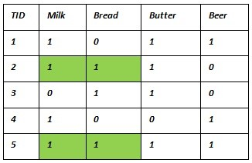
Frequent Pattern Analysis Example
How do we identify these frequent patterns from dataset (big)?
How do we justify the pattern frequencies?

Slide 5
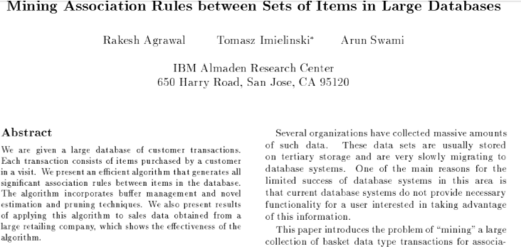
What Is Frequent Pattern Analysis?
Frequent pattern: a pattern (a set of items, subsequences, substructures, etc.) that occurs frequently in a data set
First proposed by Agrawal, Imielinski, and Swami [SIGMOD’93] in the context of frequent itemsets and association rule mining

Slide 6
Motivations of Frequent Pattern Analysis
Finding inherent regularities in data
  What products were often purchased together?— Beer and diapers?!
  What are the subsequent purchases after buying a PC?
  What kinds of DNA are sensitive to this new drug?
  Can we automatically classify web documents?
Applications
  Basket data analysis, cross-marketing, catalog design, sale campaign analysis, Web log (click stream) analysis, and DNA sequence analysis.

Slide 7
Basic Concepts: Frequent Patterns
Items bought
Beer, Nuts, Diaper
Beer, Coffee, Diaper
Beer, Diaper, Eggs
Nuts, Eggs, Milk
Nuts, Coffee, Diaper, Eggs, Milk
Customer
buys both
Customer
buys diaper
Customer
buys beer
Itemset(Dataset):
A set of one or more items
k-itemset X = {x₁, …, x_{k}}
(absolute) support, or, support count of X: Frequency or occurrence of an itemset X
(relative) support, s, is the fraction of transactions that contains X (i.e., the probability that a transaction contains X)
An itemset X is frequent if X’s support is no less than a minsup threshold

Slide 8
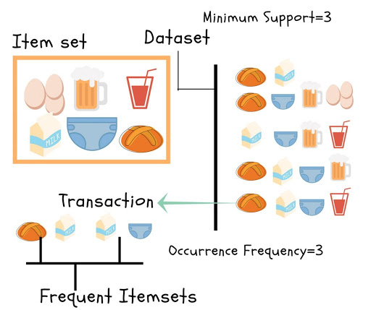
Frequent Patterns Example

Slide 9
Basic Concepts: Association Rules
Find all the rules X → Y with minimum support and confidence
  Relative support, s, probability that a transaction contains X ∪ Y
  confidence, c, conditional probability that a transaction having X also contains Y
Let minsup = 50%, minconf = 50%
Freq. Pat.: Beer:3, Nuts:3, Diaper:4, Eggs:3, {Beer, Diaper}:3
Tid
Items bought
10
Beer, Nuts, Diaper
20
Beer, Coffee, Diaper
30
Beer, Diaper, Eggs
40
Nuts, Eggs, Milk
50
Nuts, Coffee, Diaper, Eggs, Milk
Customer
buys both
Customer
buys diaper
Customer
buys beer
Association rules: (many more!)
  Beer → Diaper (60%, 100%)
  Diaper → Beer (60%, 75%)

Slide 10
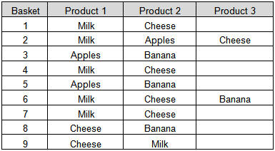
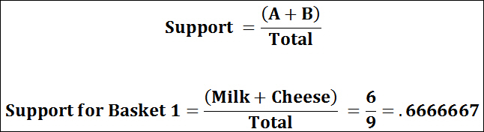
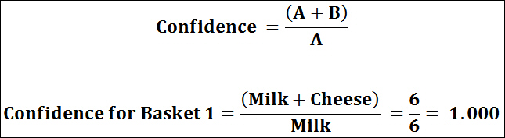
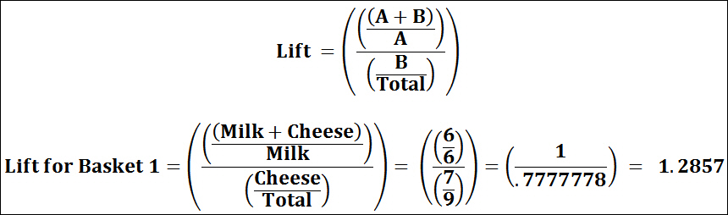
Association Rule Example
What is the support value milk + cheese?
What is the confidence value?
(!new!) The lift or lift ratio measure of confidence to expected confidence.
Expected confidence is the confidence divided by the frequency of B. The Lift tells us how much better a rule is at predicting the result than just assuming the result in the first place. Greater lift values indicate stronger associations.
Lift ration

Slide 11
Sub & Super Patterns
Sub-pattern (proper subset)
We call any proper subset of a pattern, a sub-pattern. Here is an example,
If a pattern X contains, 3 items: X={a, b, c}, any proper subsets, such as sets containing a, or b, or c, or ab, or ac, or bc, are all sub patterns.
Now, suppose we have a pattern with 100 items. How many sub-patterns can we find for this pattern?
A lot, it is more than 10 to the power of 30.
Super-pattern (proper superset)
A super pattern of a pattern is a proper super set of the pattern.
Here are some examples of the pattern containing the 3 items: a, b, c
abcd, abce, abcde, …

Slide 12
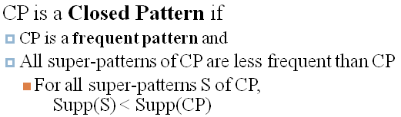
Close Pattern
A closed pattern is a frequent pattern. So it meets the minimum support criteria. In addition to that, all super-patterns of a closed pattern are less frequent than the closed pattern.
Formally, this is defined as:

Slide 13
Close Pattern example
Suppose, the minimum support count is 2.
For the first example, suppose there are a total of 3 items: a, b, c.
Suppose a pattern ab has support count of 2 and a pattern abc has support count of 2.
Is the pattern ab is a closed pattern? No
Pattern ab is a frequent pattern, but it has a super-pattern that is NOT less frequent than ab.
For the second example,
suppose there are a total of 3 items: x, y, z.
suppose a pattern xy has support count of 3 and a pattern xyz has support count of 2.
Is the pattern xy is a closed pattern? Yes
Pattern xy is a frequent pattern and also the only super-pattern xyz is less frequent than xy.
Therefore, xy is a closed pattern.

Slide 14
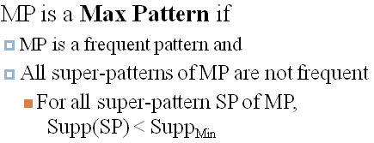
Max Pattern
A max pattern is
a frequent pattern. So it also meets the minimum support criteria like closed pattern
In addition, but unlike closed pattern, all super-patterns of a max pattern are NOT frequent patterns.
This is formally written as

Slide 15
Max Pattern examples
Suppose, the minimum support count is 2.
Like before, for the first example, suppose there are a total of 3 items: a, b, c.
Suppose a pattern ab has support count of 3 and a pattern abc has support count of 2.
Is the pattern ab is a max pattern? No
Pattern ab is a frequent pattern, but it has a super-pattern that is a frequent pattern as well. So, pattern ab is NOT a max pattern.
For the second example,
suppose there are a total of 3 items: x, y, z.
Suppose a pattern xy has support count of 3 and a pattern xyz has support count of 1.
Is the pattern xy is a max pattern? Yes
Pattern xy is a frequent pattern and also the only super-pattern xyz is NOT a frequent pattern. Therefore, xy is a max pattern.

Slide 16
Closed Patterns (CP) and
Max-Patterns (MP)
A long pattern contains a combinatorial number of sub-patterns, e.g., {a₁, …, a₁₀₀} contains (₁₀₀¹) + (₁₀₀²) + … + (₁¹₀⁰₀⁰) = 2¹⁰⁰ – 1 = 1.27*10³⁰ sub-patterns!
Solution: Mine closed patterns and max-patterns instead
An itemset X is closed if X is frequent and there exists no super-pattern Y כ X, with the same support as X
An itemset X is a max-pattern if X is frequent and there exists no frequent super-pattern Y כ X
Closed pattern is a lossless compression of freq. patterns
  Reducing the # of patterns and rules
Max-pattern is a lossy compression
  We only know max-pattern is freq. pattern but not sure the frequent support numbers.
Notes:
https://www.coursera.org/lecture/data-patterns/1-3-compressed-representation-closed-patterns-and-max-patterns-E4RdK

Slide 17
Computational Complexity of Frequent Itemset Mining
How many itemsets are potentially to be generated in the worst case?
  The number of frequent itemsets to be generated is sensitive to the minsup threshold
  When minsup is low, there exist potentially an exponential number of frequent itemsets
  The worst case: M^{N} where M: # distinct items, and N: max length of transactions
The worst case complexity vs. the expected probability
  Ex. Suppose TESCO has 10⁴ kinds of products
    The chance to pick up one product 10⁻⁴
    The chance to pick up a particular set of 10 products: ~10⁻⁴⁰
    What is the chance this particular set of 10 products to be frequent 10³ times in 10⁹ transactions?

Slide 18
Agenda
Basic Concepts
Frequent Itemset Mining Methods
Which Patterns Are Interesting?—Pattern Evaluation Methods
Summary

Slide 19
The Downward Closure Property and Scalable Mining Methods
Three major approaches
  Apriori (Agrawal & Srikant@VLDB’94)
  Freq. pattern growth (FPgrowth—Han, Pei & Yin @SIGMOD’00)
  Vertical data format approach (Charm—Zaki & Hsiao @SDM’02)

Slide 20
Apriori: A Candidate Generation & Test Approach
Method:
  Initially, scan DB once to get frequent 1-itemset
  Generate length (k+1) candidate itemsets from length k frequent itemsets
  Test the candidates against DB
  Terminate when no frequent or candidate set can be generated
Apriori pruning principle: If there is any itemset which is infrequent, its superset should not be generated/tested! (Agrawal & Srikant @VLDB’94, Mannila, et al. @ KDD’ 94)

Slide 21
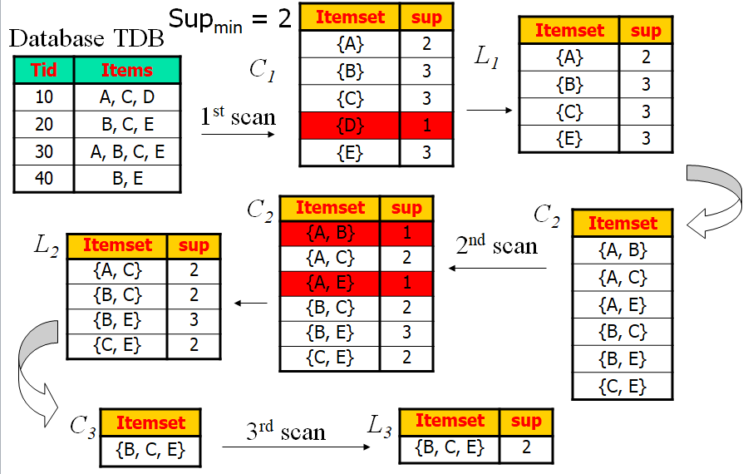
The Apriori Algorithm—An Example

Slide 22
The Apriori Algorithm - Pseudo-Code
C_{k}: Candidate itemset of size k
L_{k} : frequent itemset of size k
L₁ = {frequent items};
for (k = 1; L_{k} !=∅; k++) do begin
C_{k+1} = candidates generated from L_{k};
for each transaction t in database do
  increment the count of all candidates in C_{k+1} that are contained in t
L_{k+1} = candidates in C_{k+1} with min_support
end
return ∪_{k} L_{k};

Slide 23
Further Improvement of the Apriori Method
Major computational challenges
  Multiple scans of transaction database
  Huge number of candidates
  Tedious workload of support counting for candidates
Improving Apriori: general ideas
  Reduce passes of transaction database scans
  Shrink number of candidates
  Facilitate support counting of candidates

Slide 24
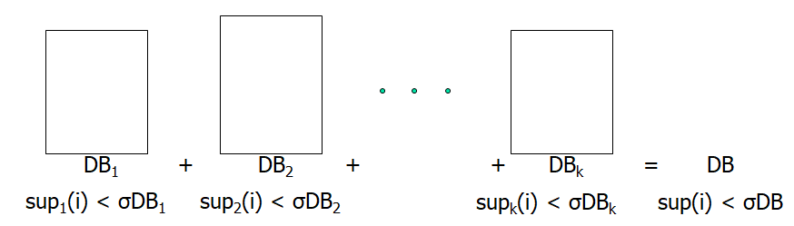
Partition: Scan Database Only Twice
Any itemset that is potentially frequent in DB must be frequent in at least one of the partitions of DB
  Scan 1: partition database and find local frequent patterns
  Scan 2: consolidate global frequent patterns

Slide 25
DHP: Reduce the Number of Candidates
A k-itemset whose corresponding hashing bucket count is below the threshold cannot be frequent
  Candidates: a, b, c, d, e
  Hash entries
    {ab, ad, ae}
    {bd, be, de}
    …
  Frequent 1-itemset: a, b, d, e
  ab is not a candidate 2-itemset if the sum of count of {ab, ad, ae} is below support threshold
J. Park, M. Chen, and P. Yu. An effective hash-based algorithm for mining association rules. SIGMOD’95
count
itemsets
35
{ab, ad, ae}
88
{bd, be, de}
Minsup=100
...
...
102
{yz, qs, wt}

Slide 26
More ideas of improvement
H. Toivonen. Sampling large databases for association rules. In VLDB’96
S. Brin R. Motwani, J. Ullman, and S. Tsur. Dynamic itemset counting and implication rules for market basket data. SIGMOD’97

Slide 27
Extension of Pattern Growth Mining Methodology
Mining closed frequent itemsets and max-patterns
  CLOSET (DMKD’00), FPclose, and FPMax (Grahne & Zhu, Fimi’03)
Mining sequential patterns
  PrefixSpan (ICDE’01), CloSpan (SDM’03), BIDE (ICDE’04)
Mining graph patterns
  gSpan (ICDM’02), CloseGraph (KDD’03)
Constraint-based mining of frequent patterns
  Convertible constraints (ICDE’01), gPrune (PAKDD’03)
Computing iceberg data cubes with complex measures
  H-tree, H-cubing, and Star-cubing (SIGMOD’01, VLDB’03)
Pattern-growth-based Clustering
  MaPle (Pei, et al., ICDM’03)
Pattern-Growth-Based Classification
  Mining frequent and discriminative patterns (Cheng, et al, ICDE’07)

Slide 28
ECLAT: Mining by Exploring Vertical Data Format
Vertical format: t(AB) = {T₁₁, T₂₅, …}
  tid-list: list of trans.-ids containing an itemset
Deriving frequent patterns based on vertical intersections
  t(X) = t(Y): X and Y always happen together
  t(X) ⊂ t(Y): transaction having X always has Y
Using diffset to accelerate mining
  Only keep track of differences of tids
  t(X) = {T₁, T₂, T₃}, t(XY) = {T₁, T₃}
  Diffset (XY, X) = {T₂}
Eclat (Zaki et al. @KDD’97)
Mining Closed patterns using vertical format: CHARM (Zaki & Hsiao@SDM’02)

Slide 29
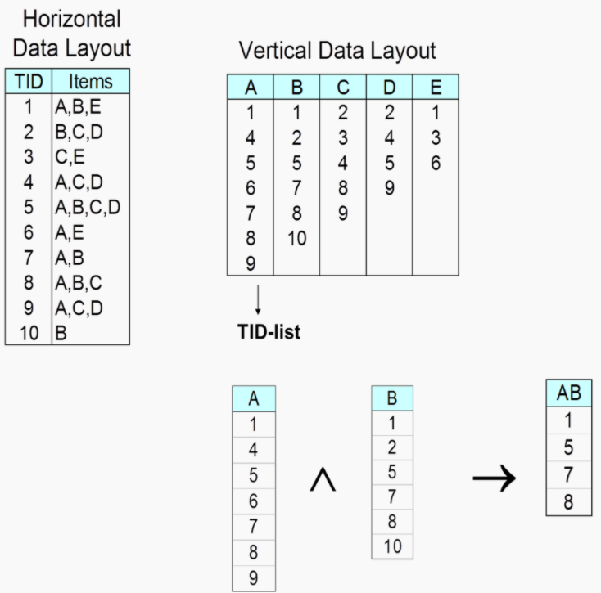

Slide 30
Summary
Basic concepts: association rules, support-confident framework, closed and max-patterns, Lift association measurement method
Scalable frequent pattern mining methods
  Apriori
  Projection-based
  Vertical format approach
Next:
Lecture: Decision Tree (Classification problem)
Practical: Decision Tree with Python

Slide 31
Ref: Basic Concepts of Frequent Pattern Mining
(Association Rules) R. Agrawal, T. Imielinski, and A. Swami. Mining association rules between sets of items in large databases. SIGMOD'93
(Max-pattern) R. J. Bayardo. Efficiently mining long patterns from databases. SIGMOD'98
(Closed-pattern) N. Pasquier, Y. Bastide, R. Taouil, and L. Lakhal. Discovering frequent closed itemsets for association rules. ICDT'99
(Sequential pattern) R. Agrawal and R. Srikant. Mining sequential patterns. ICDE'95

Slide 32
Ref: Apriori and Its Improvements
R. Agrawal and R. Srikant. Fast algorithms for mining association rules. VLDB'94
H. Mannila, H. Toivonen, and A. I. Verkamo. Efficient algorithms for discovering association rules. KDD'94
A. Savasere, E. Omiecinski, and S. Navathe. An efficient algorithm for mining association rules in large databases. VLDB'95
J. S. Park, M. S. Chen, and P. S. Yu. An effective hash-based algorithm for mining association rules. SIGMOD'95
H. Toivonen. Sampling large databases for association rules. VLDB'96
S. Brin, R. Motwani, J. D. Ullman, and S. Tsur. Dynamic itemset counting and implication rules for market basket analysis. SIGMOD'97
S. Sarawagi, S. Thomas, and R. Agrawal. Integrating association rule mining with relational database systems: Alternatives and implications. SIGMOD'98

Slide 33
Ref: Depth-First, Projection-Based FP Mining
R. Agarwal, C. Aggarwal, and V. V. V. Prasad. A tree projection algorithm for generation of frequent itemsets. J. Parallel and Distributed Computing, 2002.
G. Grahne and J. Zhu, Efficiently Using Prefix-Trees in Mining Frequent Itemsets, Proc. FIMI'03
B. Goethals and M. Zaki. An introduction to workshop on frequent itemset mining implementations. Proc. ICDM’03 Int. Workshop on Frequent Itemset Mining Implementations (FIMI’03), Melbourne, FL, Nov. 2003
J. Han, J. Pei, and Y. Yin. Mining frequent patterns without candidate generation. SIGMOD’ 00
J. Liu, Y. Pan, K. Wang, and J. Han. Mining Frequent Item Sets by Opportunistic Projection. KDD'02
J. Han, J. Wang, Y. Lu, and P. Tzvetkov. Mining Top-K Frequent Closed Patterns without Minimum Support. ICDM'02
J. Wang, J. Han, and J. Pei. CLOSET+: Searching for the Best Strategies for Mining Frequent Closed Itemsets. KDD'03

Slide 34
Ref: Vertical Format and Row Enumeration Methods
M. J. Zaki, S. Parthasarathy, M. Ogihara, and W. Li. Parallel algorithm for discovery of association rules. DAMI:97.
M. J. Zaki and C. J. Hsiao. CHARM: An Efficient Algorithm for Closed Itemset Mining, SDM'02.
C. Bucila, J. Gehrke, D. Kifer, and W. White. DualMiner: A Dual-Pruning Algorithm for Itemsets with Constraints. KDD’02.
F. Pan, G. Cong, A. K. H. Tung, J. Yang, and M. Zaki , CARPENTER: Finding Closed Patterns in Long Biological Datasets. KDD'03.
H. Liu, J. Han, D. Xin, and Z. Shao, Mining Interesting Patterns from Very High Dimensional Data: A Top-Down Row Enumeration Approach, SDM'06.

Slide 35
Ref: Mining Correlations and Interesting Rules
S. Brin, R. Motwani, and C. Silverstein. Beyond market basket: Generalizing association rules to correlations. SIGMOD'97.
M. Klemettinen, H. Mannila, P. Ronkainen, H. Toivonen, and A. I. Verkamo. Finding interesting rules from large sets of discovered association rules. CIKM'94.
R. J. Hilderman and H. J. Hamilton. Knowledge Discovery and Measures of Interest. Kluwer Academic, 2001.
C. Silverstein, S. Brin, R. Motwani, and J. Ullman. Scalable techniques for mining causal structures. VLDB'98.
P.-N. Tan, V. Kumar, and J. Srivastava. Selecting the Right Interestingness Measure for Association Patterns. KDD'02.
E. Omiecinski. Alternative Interest Measures for Mining Associations. TKDE’03.
T. Wu, Y. Chen, and J. Han, “Re-Examination of Interestingness Measures in Pattern Mining: A Unified Framework", Data Mining and Knowledge Discovery, 21(3):371-397, 2010

